Slide 1

KOSS TASK
-Abhinav R Cillanki
Codes GitHub link

Slide 2
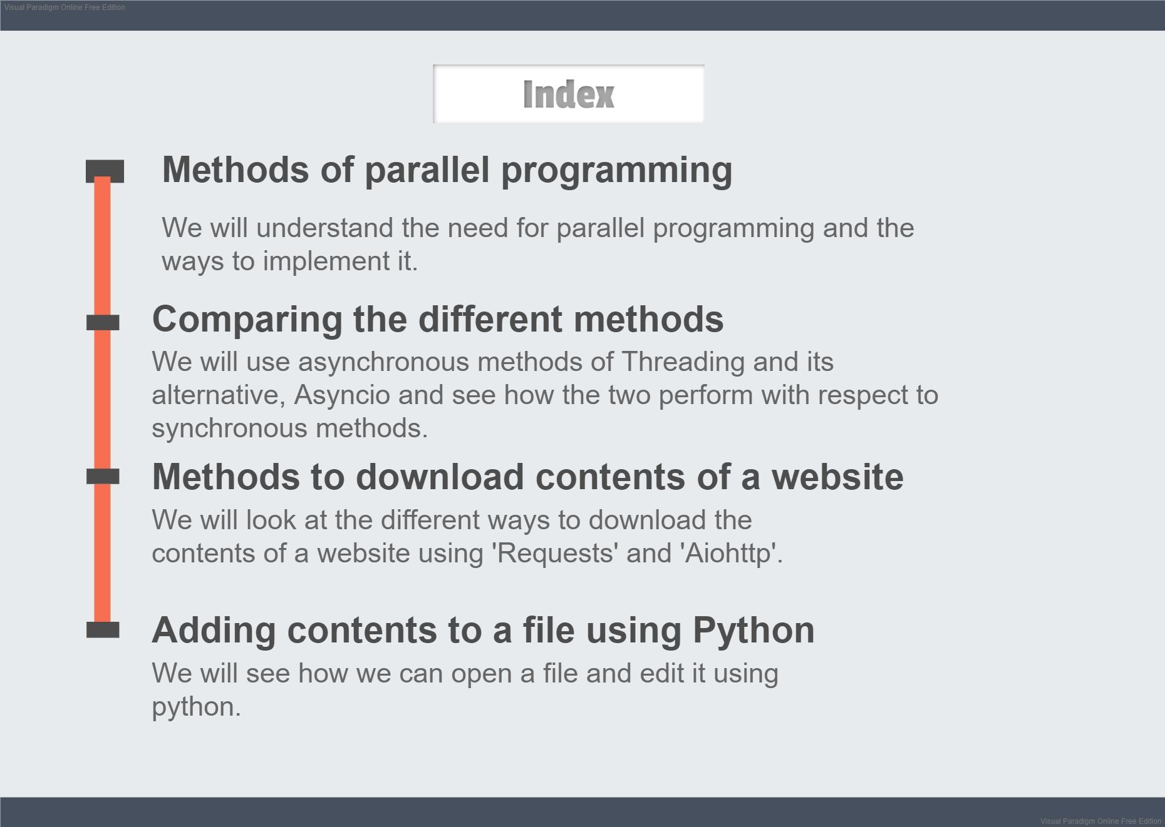

Slide 3
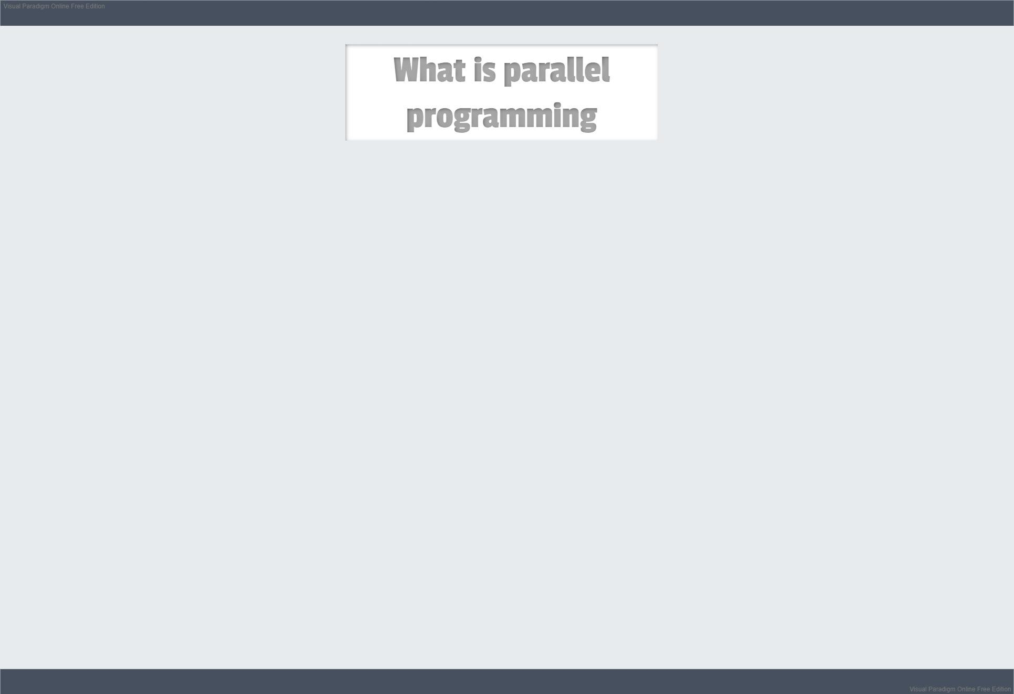
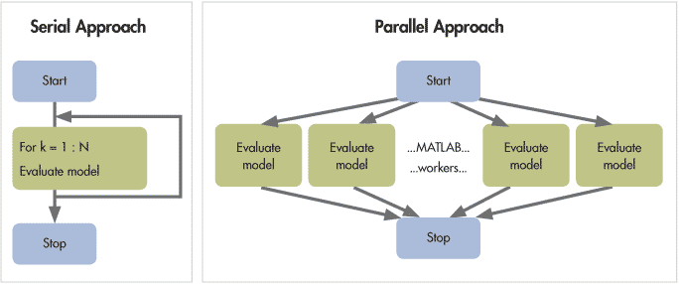

Slide 4
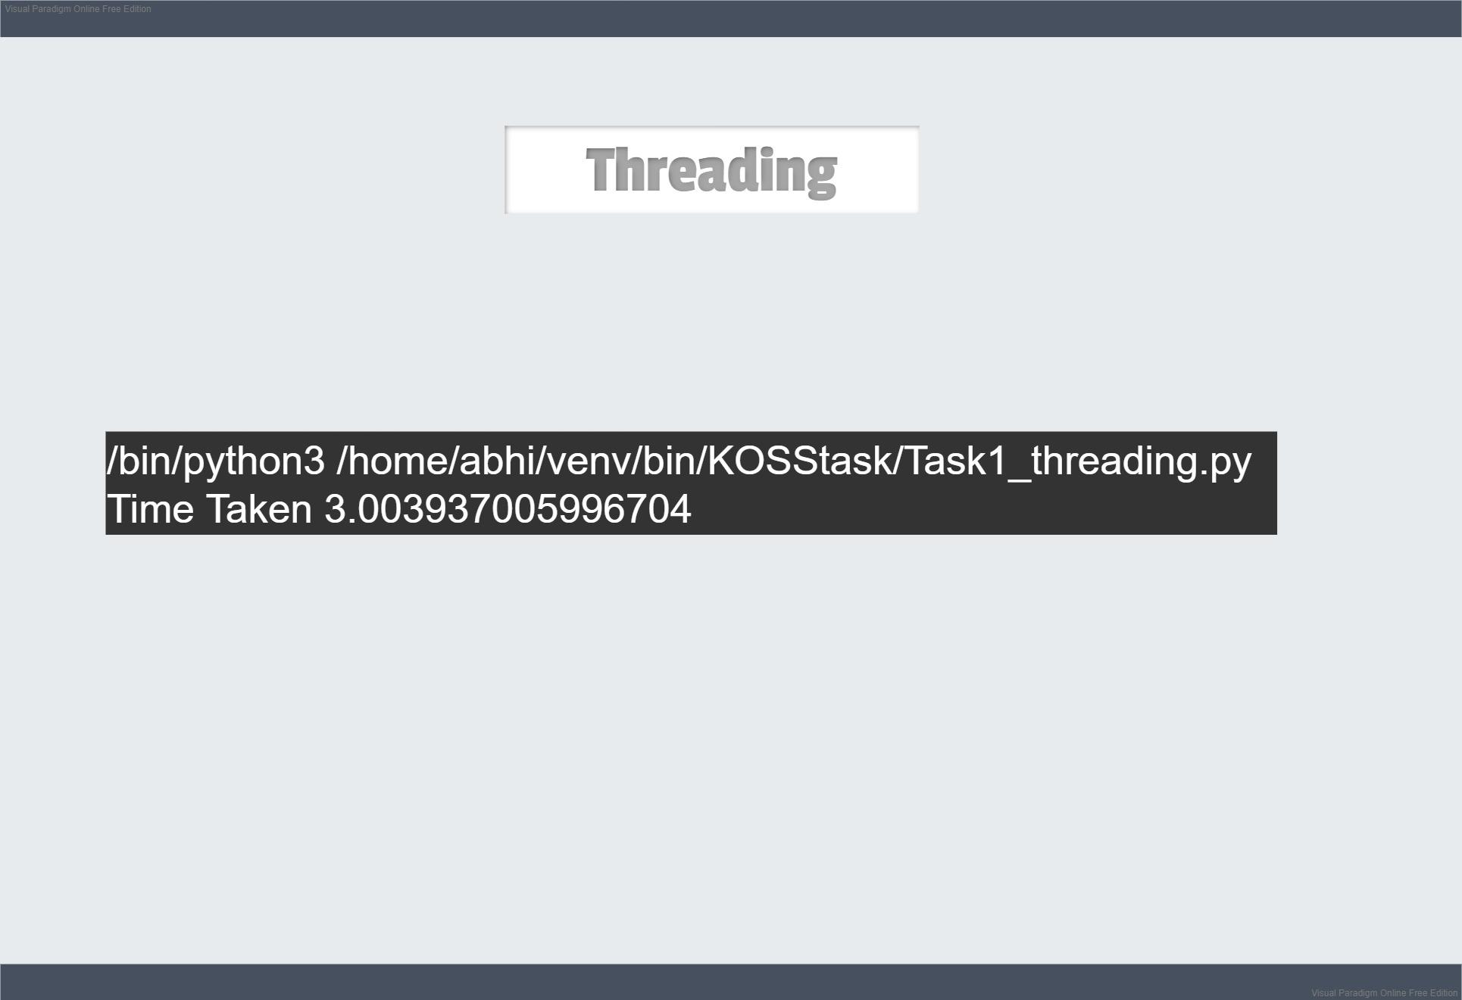
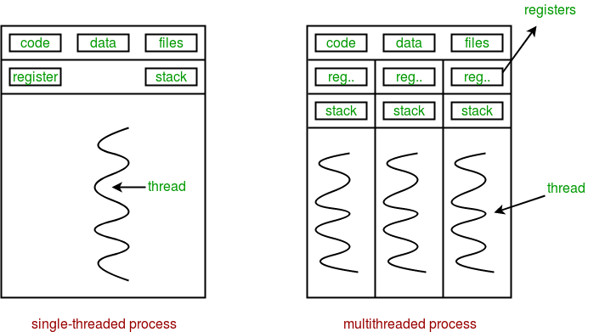

Slide 5
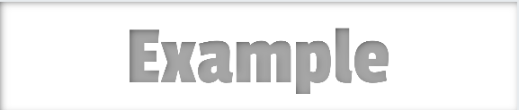
import threading
import time
def sleep_coro(duration):
time.sleep(duration)
if __name__=="__main__":
t1 = threading.Thread(target=sleep_coro, args=(1,))
t2 = threading.Thread(target=sleep_coro, args=(2,))
t3 = threading.Thread(target=sleep_coro, args=(3,))
start = time.time()
t1.start()
t2.start()
t3.start()
t1.join() #making sure all three have returned before finding time
t2.join()
t3.join()
time_taken = time.time() - start
print('Time Taken {0}'.format(time_taken))
OUTPUT:

Slide 6
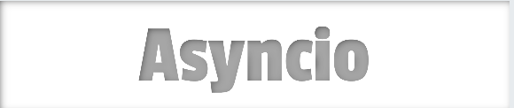
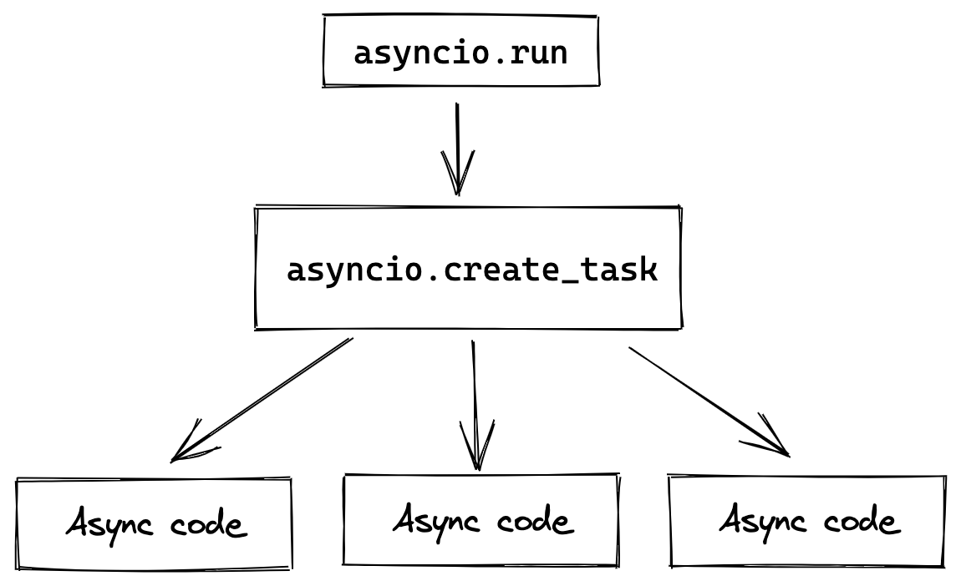

Slide 7
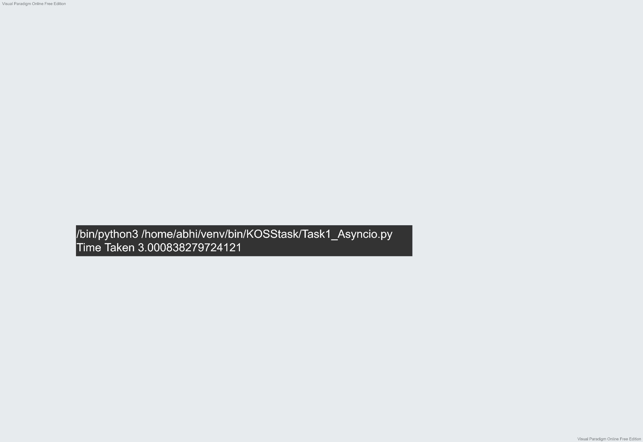
import asyncio
import time
async def sleep_coro(duration):
await asyncio.sleep(duration)
async def main():
obj1 = sleep_coro(1)
obj2 = sleep_coro(2)
obj3 = sleep_coro(3)
# See that the three object would execute synchronously,
# so it will take max(1, 2, 3) seconds to execute.
start = time.time()
await asyncio.gather(obj1, obj2, obj3)
time_taken = time.time() - start
print('Time Taken {0}'.format(time_taken))
asyncio.run(main())
OUTPUT:

Slide 8
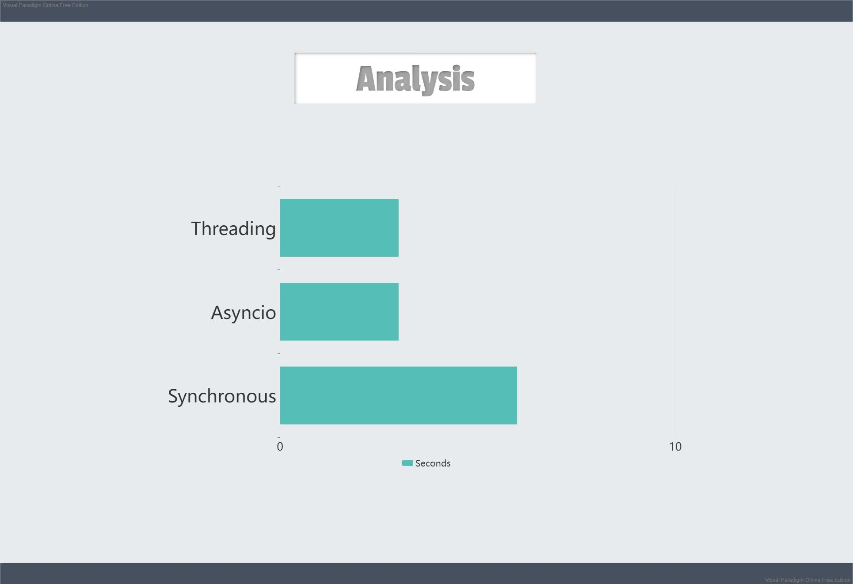
3
3
6

Slide 9
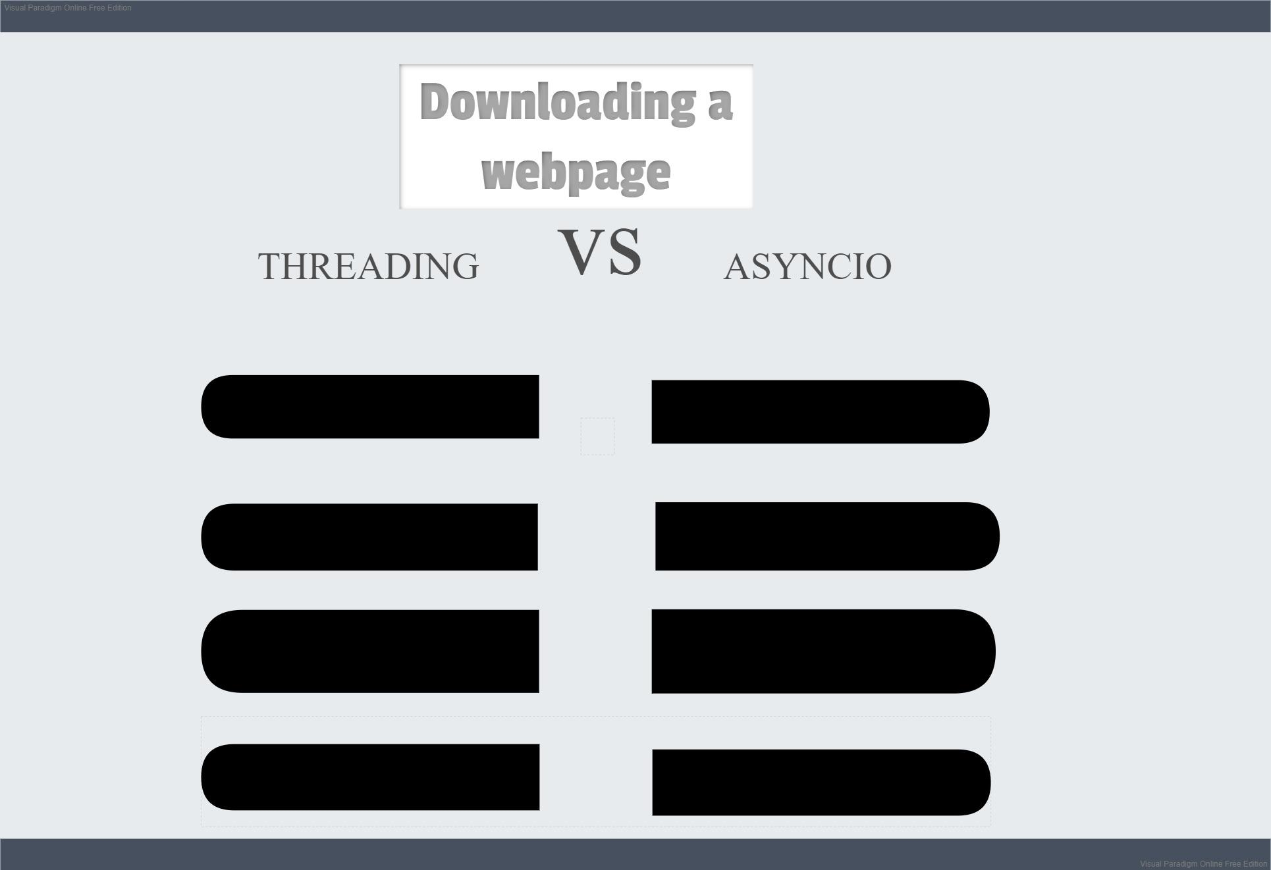
import requests
import aiohttp
async with session.get(url) as sesh:
response = requests.get(url)
async with
return response.content
aiohttp.ClientSession():
result=await sesh.text()
create t1,t2,t3...
downloads =
await getAllPages(sesh)

Slide 10
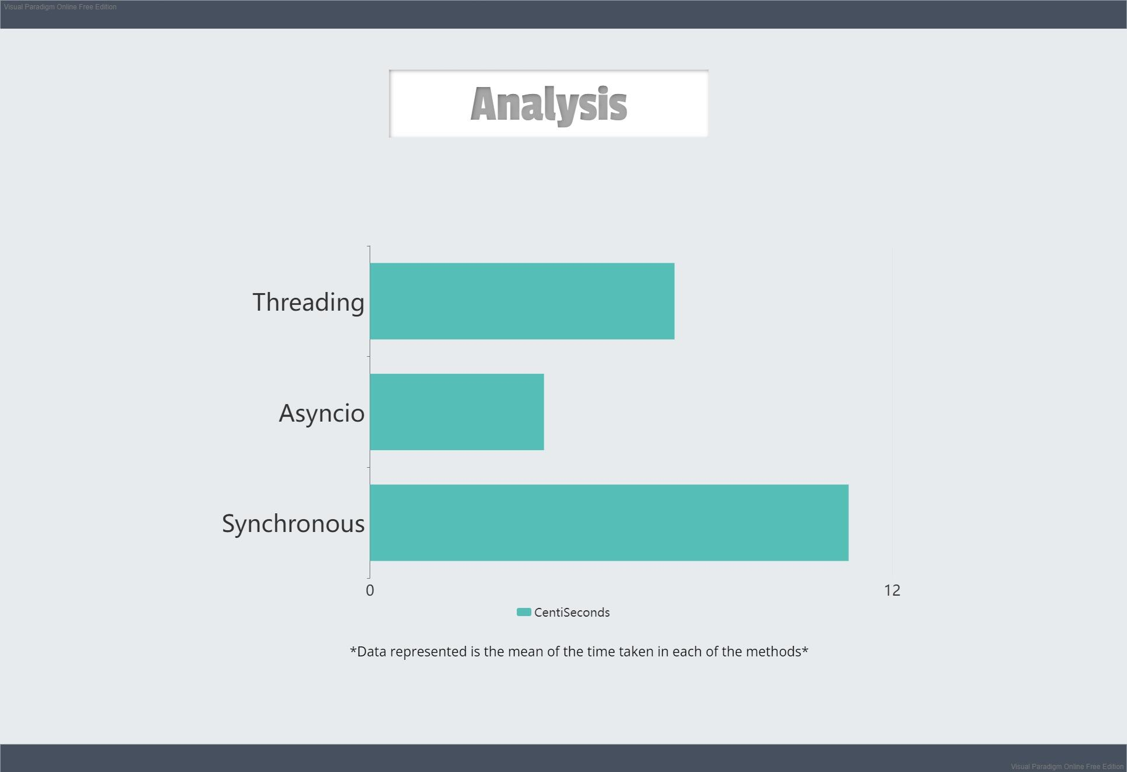
Time taken for downloading three web pages:
7
4
11

Slide 11
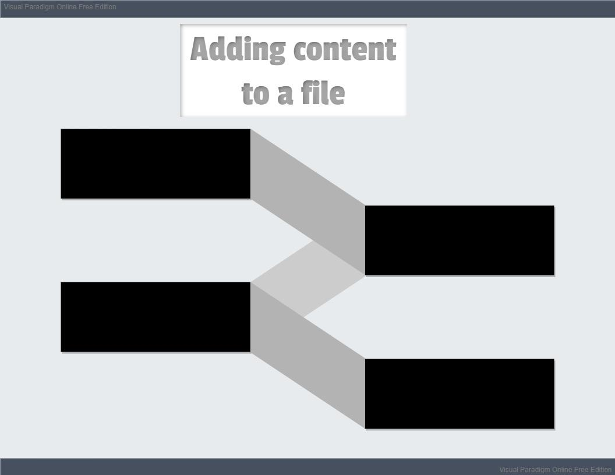
Open/create:
f=open(filename,'a+')
Opens a file, creates a new one if it is not already present
Write:
print(content,file=f)
Or f.write(content)
Adds the content to the file
Read:
f.read([n])
Or f.readline([n])
Reads content from the file
Close:
f.close()
After working the file, we close it

Slide 12
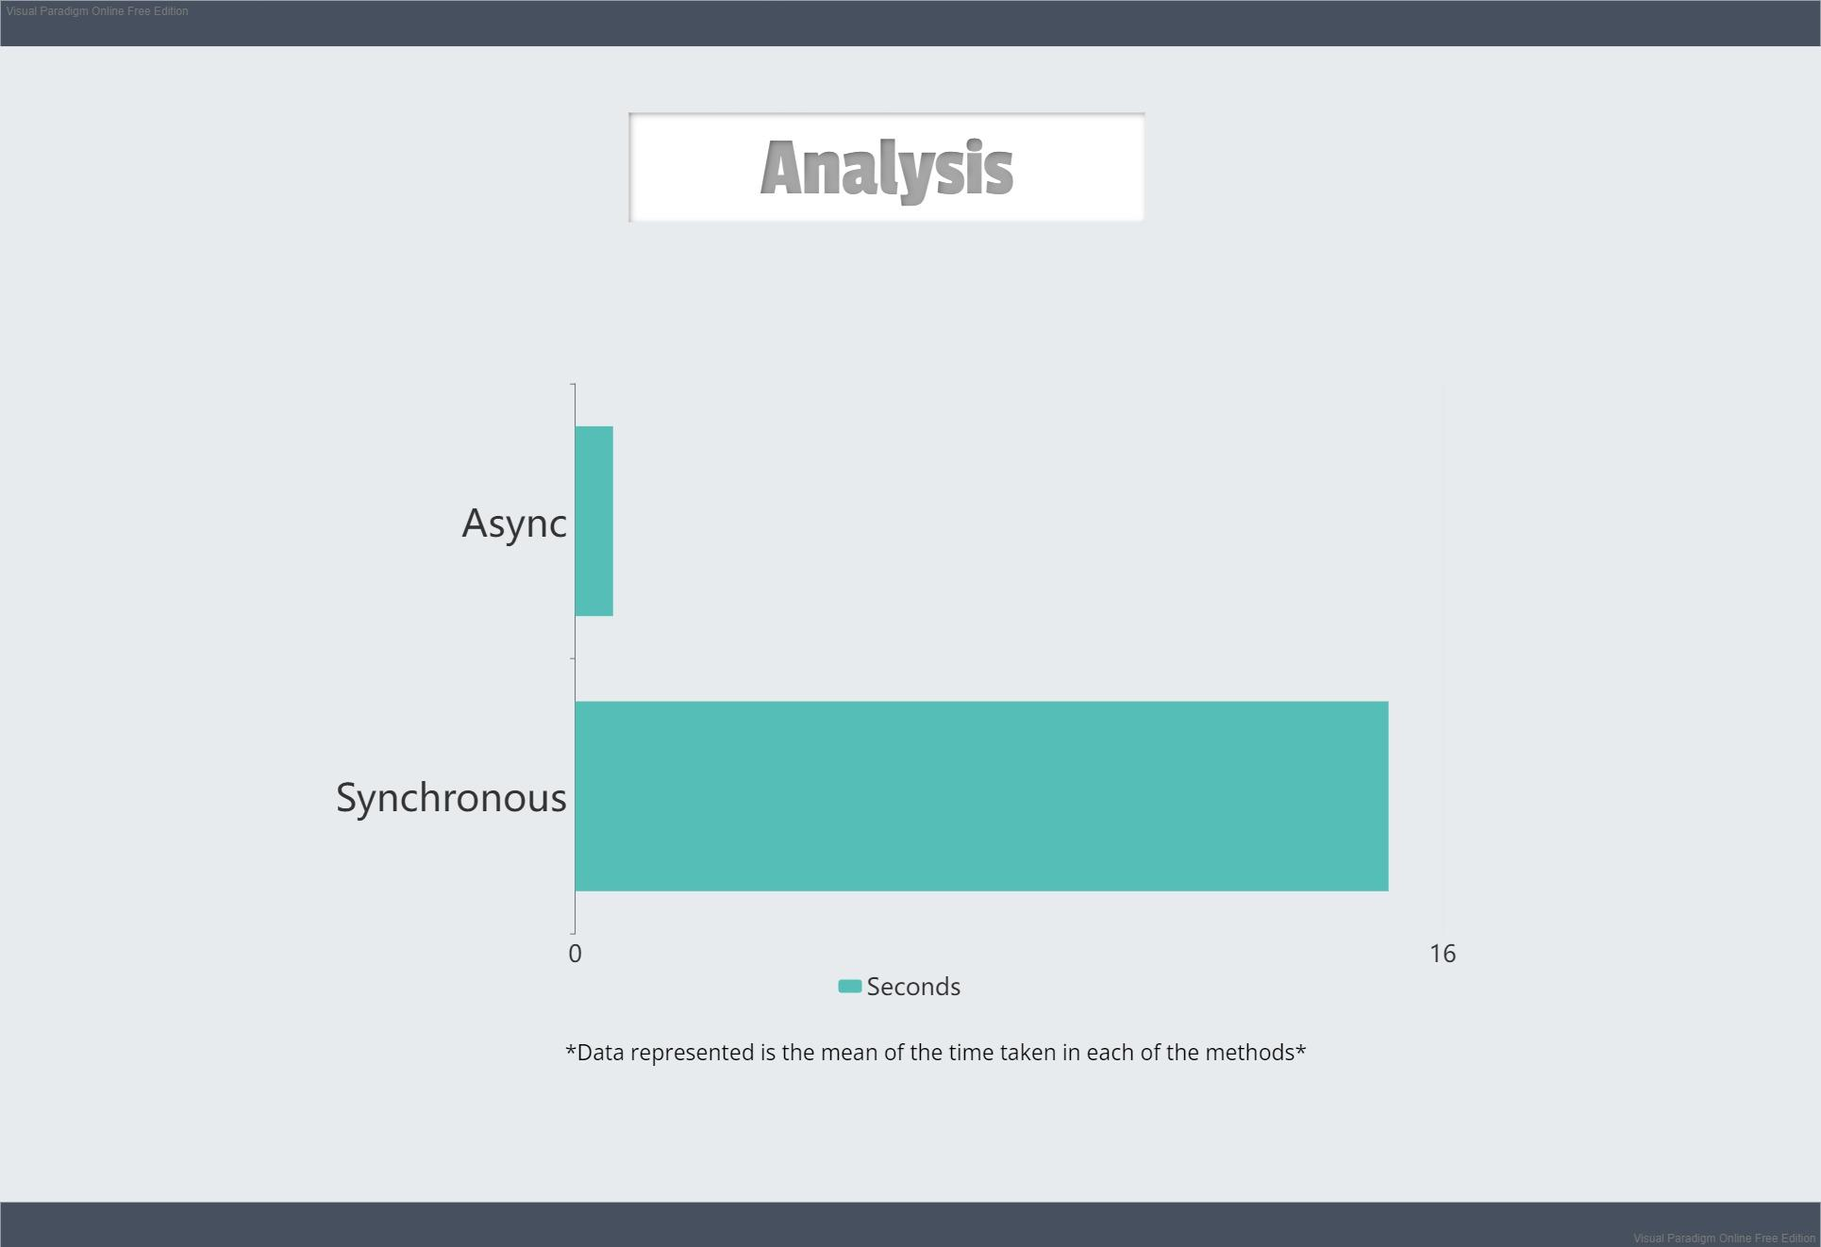
Time taken for downloading 200 web pages and adding them to a file:
0.5
15

Slide 13

Image 1 source
Image 2 source
Image 3 source
KOSS GitHub Task

Slide 14


